Slide 1










VOCABULARY
ROOT WORDS + SYNONYMS & ANTONYMS

Slide 2

HOW DO WE LEARN VOCABULARY?
Learn Tricks and Memorization Techniques
Find Context of New Words
Find Words that Might be Related to Job Spheres
Learn Synonyms and Antonyms
Learn Commonly Used Words in Vocabulary Tests
Learn Root-words Prefixes and Suffixes
Practice Regularly

Slide 3

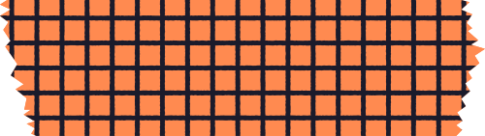
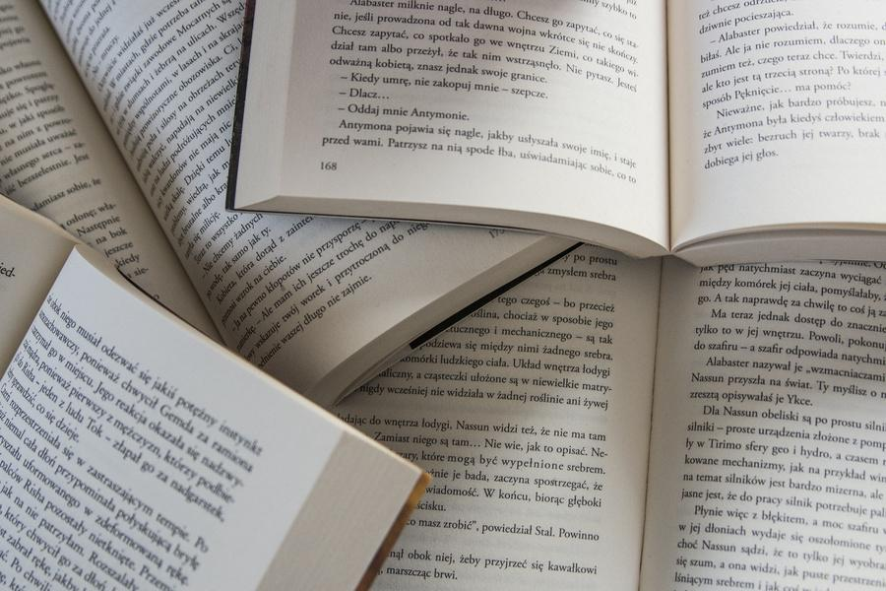

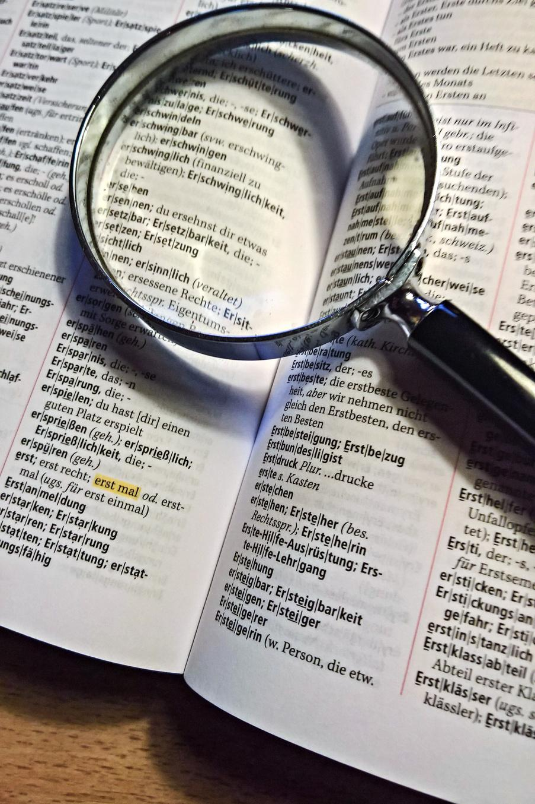
HOW TO SOLVE A VOCABULARY QUESTION?
Knowledge of synonyms and antonyms
Practice using the word
Identify the word

Slide 4
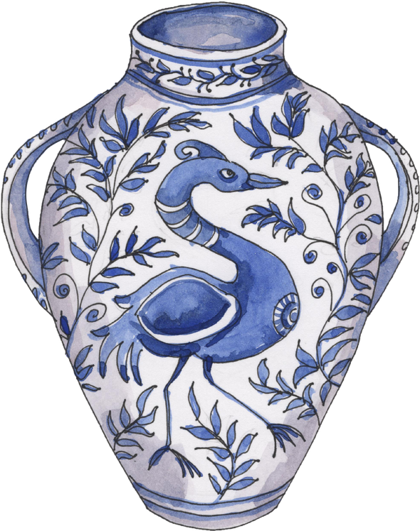

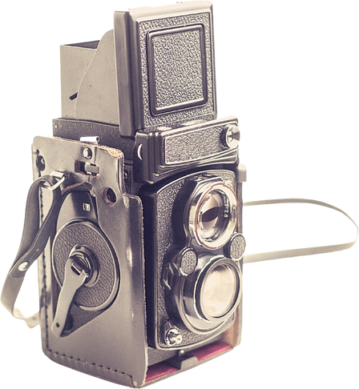
LET’S TAKE AN EXAMPLE
Synonym - Ancient
Antonym - Modern
People love to see the antique items
Antique, i.e., old

Slide 5


ROOT WORDS
A root word is a word or word part that can form the basis of new words through the addition of prefixes and suffixes.
Understanding the meanings of common roots can help you work out themeanings of new words as you encounter them.

Slide 6


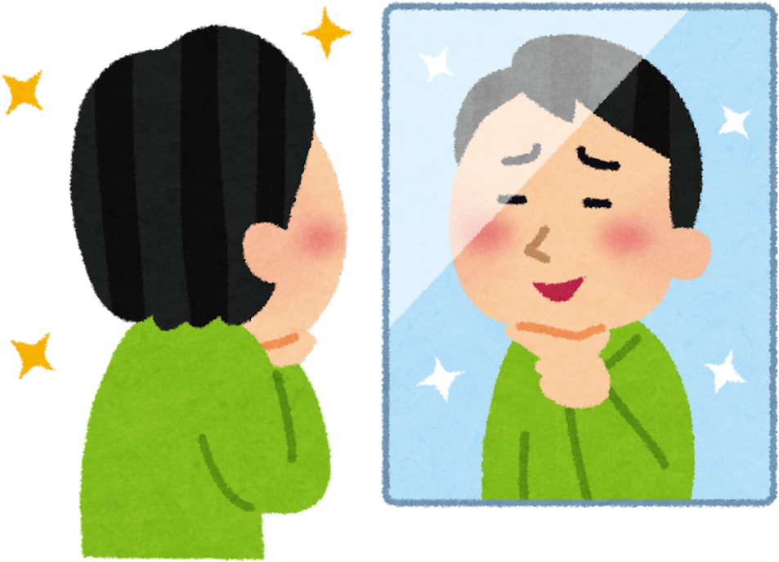
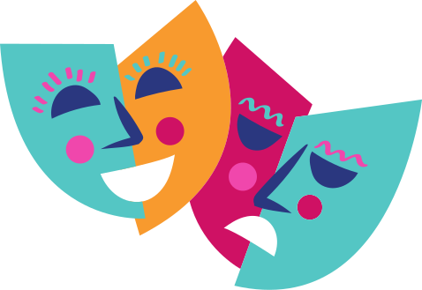
egoist
acting
ego + -ist
act + -ing

Slide 7


Acri: bitter
(acrid, acrimony, acridity)
Astro: star
(astronaut, astronomy, astrophysics)
Root Words That Can Stand Alone
Act: to move or do
(actor, acting, reenact)
Crypt: to hide
(apocryphal, cryptic, cryptography)
Root Words as Word Stems

Slide 8




Root Hunt Exercise
Ambul
Cardio
Cede
Counter
Dem
A. heart
B. people
C. against or opposite
D. to go or yield
E. to move or walk

Slide 9
Root Hunt - ANSWERS
Ambul
Cardio
Cede
Counter
Dem
A. to move or walk
B. heart
C. to go or yield
D. against or opposite
E. people

Slide 10

BUILD-A-WORD
Ambul
Dem
Cardio
Counter
Cede

Slide 11

democracy democrat demographic
amble ambulance ambulate
cardiovascular
electrocardiogram
cardiology
counteract
counterpoint
counterargument
intercede
recede
concede

Slide 12

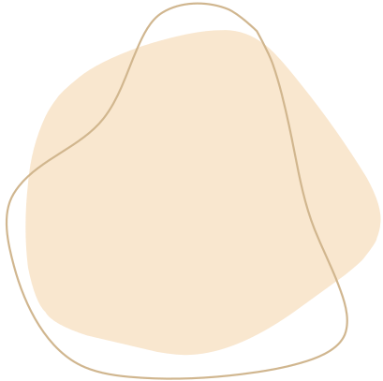


SYNONYMS
Importance of Synonyms
words that are similar to another word or have a related meaning
to avoid repeating the same word
to convey the most appropriate meaning

Slide 13


Synonym Showdown
1
colossal
terrific
2
polite
gigantic
3
glorious
skilled
4
immense
corteous
5
accomplished
spacious

Slide 14
ANSWERS
1
colossal
immense
2
gigantic
spacious
3
glorious
terrific
4
polite
courteous
5
accomplished
skilled

Slide 15




Synonym Story Relay
colossal
gigantic
glorious
courteous
accomplished
immense
spacious
terrific
polite
skilled
INSTRUCTIONS:
The first student will choose a word and make a sentence with it.
The next student will choose another word and make a sentence that will continue the story.

Slide 16
ANTONYMS
Importance of Antonyms
a word that means the opposite of another word
to express constrasting ideas and states
to identify the meaning of unfamiliar words

Slide 17
Opposite Match Mania
1
abundant
cowardly
2
timid
artificial
3
bold
amiable
4
scarce
intrepid
5
grumpy
natural

Slide 18
ANSWERS
1
abundant
scarce
2
artificial
natural
3
bold
timid
4
cowardly
intrepid
5
grumpy
amiable

Slide 19
Antonym Atmospheres
abundant
scarce
artificial
natural
bold
timid
intrepid
cowardly
grumpy
amiable
INSTRUCTIONS:
The first student will choose a word and make a sentence with it that describes a scene.
The next student will choose another word and make a sentence that will continue the description.

Slide 20








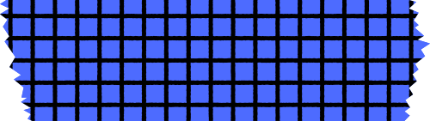




THANK YOU FOR LISTENING!

